Slide 1
IOS True Definition as a New Tool to Analyze the Clinical Performance of Restorative Materials.
EPA-SEPES
DIGITAL NATIVES IN PROSTHODONTICS.
42ND ANNUAL CONFERENCE.
AUTHORS
Meriem Benabdallah, DDS, MsC
Nerea Urcelay Moreno, DDS, MsC
Andrea Santamaría Laorden, DDS, MsC, PhD
Notes:
first of all I wanted to thank the committee for the opportunity to present our work in progress.
My name is meriem benabdallah, I am a PhD student at the European university of Madrid, and with the team I am working with we have decided to call this
Presentation: IOS true definition as a new tool to analyse the clinical performance of restorative materials.

Slide 2
INTRODUCTION
Clinical evaluation of the efficacy of a newly developed glass ionomer restorative for posterior restorations in an adult population. Pilot Study.
3M Oral Care study number CR 15/15
Research based on the COMPARISION of 2 glass ionomers in class II restorations
KETAC MOLAR vs KETAC UNIVERSAL
The need of a previous preparation of the cavity.
$$≠$$
The purpose is to compare the evolution of both materials in the patients oral cavity.
Notes:
We are working in a research project called Clinical evaluation of the efficacy of a newly developed glass ionomer restorative for posterior restorations in an adult population. Pilot study.
Our line of investigation stems from our involvement in this research Project with 3M Germany; where the goal is to conduct a 5years comparative(comparison) study between two class II restorations in Split mouth with two different glass ionomers.

Slide 3
INTRODUCTION
HOW IS THE COMPARISON BEING MADE?
CLINICAL EYE. 2 blind evaluators
Based on the Peters et al. Clinical Performance Criteria
Notes:
The comparison is performed by two blinded evaluators through visual inspection based on the Clinical Performance Criteria of Peters et al.; as well as through a digital scan of both arches.
The evaluated factors are: Retention of the restoration, fractures, the marginal staining and the surface of the restoration, the wear, postoperative sensitivity, the caries associated to the restoration and the integrity of the tooth. They are graded on a scale of 1 to 5 depending on the degree of the alteration.

Slide 4
INTRODUCTION
HOW IS THE COMPARISON BEING MADE?
FULL ARCH DIGITAL IMPRESSION
Scanning with the IOS TrueDefinition
Notes:
The second way of evaluation is as said previously by a scan of the arches of the patient.
The IOS true definition generates the image through a 3D-in motion- video technology.
The high level of accuracy of the IOS true definition, an accuracy of 10microns, made us consider alternative uses for it.
Within the first 6months, and talking in a scale of microns, we have been able to observe changes in the patients arches that the human eye would not be able to detect; both in the dental structure of enamel and dentin, as well as in previous restorations of the patient and in the ones made by us.

Slide 5
INTRODUCTION-----borrar diapo
TRUE DEFINITION
IntraOral Scanner [IOS]
Images in a scale of Greys
Accuracy of 10 microns
Open files
¡NO creo que se muy necesaria describirlo hablando!
Mas comentar el nuevo uso que queremos darle¿?
Notes:
The high level of accuracy of the IOS true definition, an accuracy of 10microns, made us consider alternative uses for it.
Within the first 6months, and talking in a scale of microns, we have been able to observe changes in the patients arches that the human eye would not be able to detect; both in the dental structure of enamel and dentin, as well as in previous restorations of the patient and in the ones made by us.

Slide 6
INTRODUCTION
NEW USES FOR THE TRUE DEFINITION
The known uses are for
ORTHODONTICS
PROSTHODONTICS
IMPLANT DENTISTRY
NEW USE --- Detecting the WEAR
Detecting the WEAR and UNDERSTANDING the causes
WHY?
To try to prevent it and desaccelerate the degradation process
HOW?
Overlapping the obtained STL files with a specific programm and analyzing each case and it´s specificities
Notes:
We all know that today the use the IOS is a more and more used tool in orthodontics and prosthetic dentistry.
While we are in the middle of a research, we wanted to find more uses to it. IN THIS CASE because it is able to detect microns of wear when overlapping the STL files obtained WE want to try to understand the different reasons of the wear so we can try to prevent or reduce it.

Slide 7
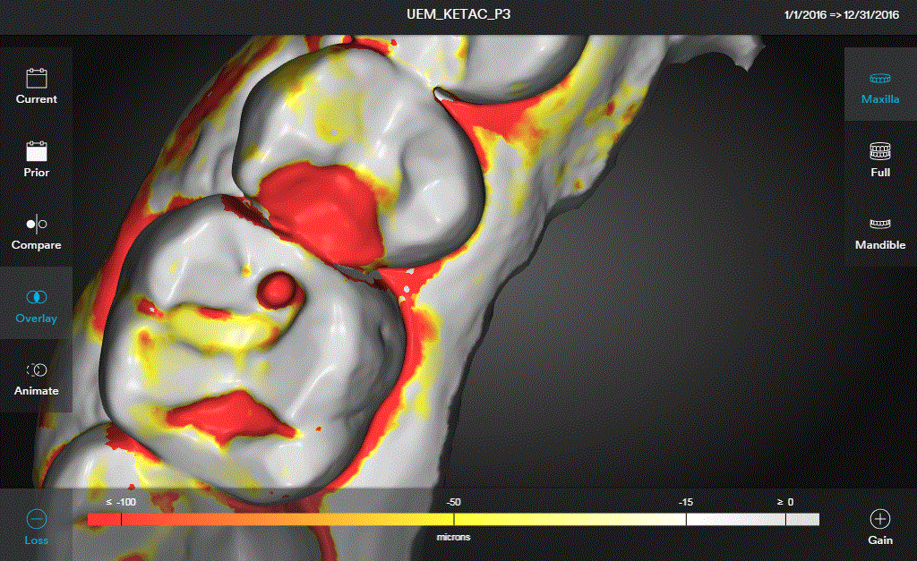
INTRODUCTION
NEW USE FOR THE IOS WHEN OVERLAPPING THE SCANS
DETECTING THE WEAR
PREVENTING THE ALTERATIONS
OVERLAPPING STL FILES
UNDERSTANDING CAUSES
HOW?
WHY?
Resulting image from overlapping two scans
Notes:
For this new function, the systematic is, once the arches are scanned in a different time lapse , an overlapping of the STL files is done to compare the changes.
Once the changes are detected, like a loss of structure measured in microns, we can start analysing the quantities of loss, the localisation and the probable causes.
Only by really understanding the origin of the wear we can try to prevent it, decelerate the process or solve it.

Slide 8
INTRODUCTION
Abrasion
Attrition
Abfraction
Cupping
Occlusion
Bruxism
DENTAL WEAR
Notes:
Dental wear is a concept that englobes lesions due to the effect
Erosion, attrition, abrasion and abfraction are four different types of morphological lesions englobed in the concept of dental wear.
And by dental wear we speak about the loss of structure that are non-carious lesions.
“The academy of general dentistry, in 2007, made the claim that erosion is more frequent than it was 5 years ago. After the surveying they also felt the need to form a more specific definition for the terms in order to reduce the free interpretation of them.
The etiology is quite difficult to determine; in consequence the definitions are not as accurate as needed.

Slide 9
DENTAL WEAR
INTRODUCTION
EROSION
ACID CUPPING
ABRASION
ATTRITION / GRINDING
Notes:
This pictures are from evolved cases and we can clearly see the differences between a lesion caused by abnormal mechanical forces like the abrasion that can convert in abfraction, the one were a chemical process is causing the deterioration, like for the erosion and acid cupping, and the one caused by the grinding and bruxism causing attrition lesions.
Nowadays, the etiological processes still need to be detailed, the general thinking is a multifactorial origin.
The etiological factors that contributes to the creation of the lesion could help identify ”problems” within the oral cavity as well as other types of non-oral disorders and prevent them.

Slide 10
OBJECTIVES
To compare and correlate the Peters et al Clinical Performance Criteria analyzed visually and through the IOS images
To determine responsible factors of the wear through the overlapping of the scans

Slide 11
RESULTS
Picture at 6 months
CRITERIAS | VISUAL INSPECTION |  | SCANNER INSPECTION
 | Evaluator1 | Evaluator2 | Evaluator1 | Evaluator2
RETENTION
FRACTURES
SURFACE STAINING
WEAR
POSTOPERATIVE SENSITIVITY
CAR
TOOTH INTEGRITY
Baseline Scan vs Scan at 6m
Notes:
Comparison between the real picture and the IOS scan analysed by the Peters factors. ¿Is there a correlation?
In the table we can see the different grades that have been given by the two evaluators while exploring visually the restoration a through the image given by the IOS.
The factor that neither the eye nor the IOS can grade is the postoperative sensitivity, this one depends on the answer of the patient.
The true definition do not allow us to evaluate the surface staining because we obtain images in scale of greys.
For the caries, only the ones associated to a real decay could be diagnosed as well as only an important loss of retention.
Fractures, wear and tooth integrity are three factors that we can visualize with high details specially when an overlapping of the images is made. The images are very accurate and with a high level of details.

Slide 12
RESULTS
Scan Overlapped Image at 6m
CRITERIAS | VISUAL INSPECTION |  | SCANNER INSPECTION
 | Evaluator1 | Evaluator2 | Evaluator1 | Evaluator2
RETENTION
FRACTURES
SURFACE STAINING
WEAR
POSTOPERATIVE SENSITIVITY
CAR
TOOTH INTEGRITY
Baseline Scan vs Scan at 6m
Notes:
Comparison between the real picture and the IOS scan analysed by the Peters factors. ¿Is there a correlation?
In the table we can see the different grades that have been given by the two evaluators while exploring visually the restoration a through the image given by the IOS.
The factor that neither the eye nor the IOS can grade is the postoperative sensitivity, this one depends on the answer of the patient.
The true definition do not allow us to evaluate the surface staining because we obtain images in scale of greys.
For the caries, only the ones associated to a real decay could be diagnosed as well as only an important loss of retention.
Fractures, wear and tooth integrity are three factors that we can visualize with high details specially when an overlapping of the images is made. The images are very accurate and with a high level of details. (COLOREAR PUNTUACION PARA RESALTAR)

Slide 13
PATIENT STUDY Nº3 What do we see comparing images?
Mandible overlapping scans, at day 1 and 6months
Notes:
The baseline to 6months time, Is the overlapping were we can see the more obvious changes.
Within 6 months, In the original dental structure we can see in 36/16 how a cupping lesion is being formed. Our first suspicion is due to an acid environment.
If you concentrate on tooth number 35(composite restoration) , you can see how the lateral walls of the composite are disappearing, that makes us think that a chemical process is responsible for the wear on that area because is a contactless area of the tooth.
In tooth 45, there is an obvious active process where a loss of structure is going on too.

Slide 14
PATIENT STUDY Nº3 What do we see comparing images?
2. Mandible overlapping scans, at day 1 and 1 year
Notes:
in this baseline to a year overlapping, the lesions are the same than in the anterior one with a little bit more of evolution.
Special attention to the canine, the origin of the wear process is physical, but see how once it arrives to the dentin, the process accelerates. In the scale theredcolour means 50 microns in a year.

Slide 15
PATIENT STUDY Nº3 What do we see comparing images?
3. Mandible overlapping scans, at 6 month and a year
Notes:
The overlapping made with the 6 months and a year scan showed us that the wear evolution stabilizes, even tough we can see that the process is still active.
This last scan confirm that the dental wear is real.

Slide 16
DISCUSSION What do we see comparing images?
Many questions come to mind
Is there a real correlation between the oral cavity acidity and the wear?
Will it be necessary to include as an indication for some restoration materials the pH of the cavity?
Notes:
After analysing the maxilla and mandible of the anterior case, many questions come to mind.
1. Is there a real correlation between the oral cavity acidity and the wear?
2. Will it be necessary to include as an indication for some restoration materials the pH of the cavity?
The truth is that no concrete answers can be given at this point, we are still in an observational phase and it would be premature from us to start taking conclusion.
We think that more analysis and more cases must be studied.

Slide 17
DISCUSSION What do we see comparing images?
Conclusions for this particular case
No concrete answers can be give at this point.
More analysis and more cases must be studied.
Notes:
The truth is that no concrete answers can be given at this point, we are still in an observational phase and it would be premature from us to start taking conclusion.
We think that more analysis and more cases must be studied.
*The cupping and cratering that have been formed have a controversial primary cause and are generally due to different effects.*

Slide 18
CONCLUSIONS
A correlation have been found between / no correlation have been found¿?
No specific factors have been determined yet in relation to the different types of wear.

Slide 19
REFERENCES
Dzakovich JJ, Oslak D. In vitro effects of acid challenge on incisal/occlusal cupping/cratering. J Prosthet Dent. 2017;117(1):124-131.
Academy of General Dentistry. What you told us about tooth erosion. Academy of General Dentistry Impact. 2007;35(N6):19-21.
The Journal of prosthetic Dentistry. The Glossary of prosthodontics terms. J Prosthet Dent 2005; 94:10-92.
Nascimiento M et al. Abfraction lesions. Etiology, diagnosis, and treatment options. Clin Cosmet Investig Dent 2016; 8:79-87.
Chronopoulos V et al. Complete mouth rehabilitation and gastroesophageal reflux disease: conventional and contemporary treatment approaches. J Prosthet Dent. 2017;117(1):1-7.
Litonjua LA et al. Tooth wear: attrition, erosion and abrasion. Restor Dent. 2003;34(6):435-446.
Levrini L, Di Benedetto G, Raspanti M. Dental Wear: A scanning Electron Microscope Study. Biomed Res Int. 2014;340435:7pg.
Telles D et al. Prevalence of noncarious cervical lesions and their relation to occlusal aspects: A clinical study. J Esthet Dent 200;12:10-15.
Huysman M.C.D.N.J.M, ChewH.P, Ellwood R.P. Clinical studies of dental erosion and erosive wear. Caries Res 2011;45(suppl1):60-68.

